Slide 1

The Hierarchical Approach
17UCS330207
Data Base Systems
II B.SC CS
Rev. Dr. S. Arul Oli SJ
Assistant Professor

Slide 2
Relational Data Base Management System
Rev. Dr. S. Arul Oli SJ

Slide 3
What is a Database?
A database is a collection of related data which represents some aspect of the real world.
A database system is designed to be built and populated with data for a certain task.
What is DBMS?
Database Management System (DBMS) is a software for storing and retrieving users' data while considering appropriate security measures.
It consists of a group of programs which manipulate the database.
The DBMS accepts the request for data from an application and instructs the operating system to provide the specific data.
In large systems, a DBMS helps users and other third-party software to store and retrieve data.
DBMS allows users to create their own databases as per their requirement.
The term “DBMS” includes the user of the database and other application programs. It provides an interface between the data and the software application.

Slide 4
Example of a DBMS
Example of a university database. This database is maintaining information concerning students, courses, and grades in a university environment. The database is organized as five files:
The STUDENT file stores data of each student
The COURSE file stores contain data on each course.
The SECTION stores the information about sections in a particular course.
The GRADE file stores the grades which students receive in the various sections
The TUTOR file contains information about each professor.
To define a database system:
We need to specify the structure of the records of each file by defining the different types of data elements to be stored in each record.
We can also use a coding scheme to represent the values of a data item.
Basically, your Database will have 5 tables with a foreign key defined amongst the various tables

Slide 5
History of DBMS
Here, are the important landmarks from the history:
1960 - Charles Bachman designed first DBMS system
1970 - Codd introduced IBM'S Information Management System (IMS)
1976- Peter Chen coined and defined the Entity-relationship model also know as the ER model
1980 - Relational Model becomes a widely accepted database component
1985- Object-oriented DBMS develops.
1990s- Incorporation of object-orientation in relational DBMS.
1991- Microsoft ships MS access, a personal DBMS and that displaces all other personal DBMS products.
1995: First Internet database applications
1997: XML applied to database processing. Many vendors begin to integrate XML into DBMS products.

Slide 6
Characteristics of Database Management System
Provides security and removes redundancy
Self-describing nature of a database system
Insulation between programs and data abstraction
Support of multiple views of the data
Sharing of data and multiuser transaction processing
DBMS allows entities and relations among them to form tables.
It follows the ACID concept (Atomicity, Consistency, Isolation, and Durability).
DBMS supports multi-user environment that allows users to access and manipulate data in parallel.

Slide 7
DBMS | Flat File Management System
Multi-user access | It does not support multi-user access
Design to fulfill the need for small and large businesses | It is only limited to smaller DBMS system.
Remove redundancy and Integrity | Redundancy and Integrity issues
Expensive. But in the long term Total Cost of Ownership is cheap | It's cheaper
Easy to implement complicated transactions | No support for complicated transactions

Slide 8
Users in a DBMS environment
Component Name | Task
Application Programmers | The Application programmers write programs in various programming languages to interact with databases.
Database Administrators | Database Admin is responsible for managing the entire DBMS system. He/She is called Database admin or DBA.
End-Users | The end users are the people who interact with the database management system. They conduct various operations on database like retrieving, updating, deleting, etc.

Slide 9
Application of DBMS
Sector | Use of DBMS
Banking | For customer information, account activities, payments, deposits, loans, etc.
Airlines | For reservations and schedule information.
Universities | For student information, course registrations, colleges and grades.
Telecommunication | It helps to keep call records, monthly bills, maintaining balances, etc.
Finance | For storing information about stock, sales, and purchases of financial instruments like stocks and bonds.
Sales | Use for storing customer, product & sales information.
Manufacturing | It is used for the management of supply chain and for tracking production of items. Inventories status in warehouses.
HR Management | For information about employees, salaries, payroll, deduction, generation of paychecks, etc.

Slide 10

Four Types of DBMS systems are:
Hierarchical database
Network database
Relational database
Object-Oriented database

Slide 11
Hierarchical DBMS
In a Hierarchical database, model data is organized in a tree-like structure. Data is Stored Hierarchically (top down or bottom up) format. Data is represented using a parent-child relationship. In Hierarchical DBMS parent may have many children, but children have only one parent.
Network Model
The network database model allows each child to have multiple parents. It helps you to address the need to model more complex relationships like as the orders/parts many-to-many relationship. In this model, entities are organized in a graph which can be accessed through several paths.
Relational model
Relational DBMS is the most widely used DBMS model because it is one of the easiest. This model is based on normalizing data in the rows and columns of the tables. Relational model stored in fixed structures and manipulated using SQL.
Object-Oriented Model
In Object-oriented Model data stored in the form of objects. The structure which is called classes which display data within it. It defines a database as a collection of objects which stores both data members values and operations.

Slide 12
Advantages of DBMS:
DBMS offers a variety of techniques to store & retrieve data
DBMS serves as an efficient handler to balance the needs of multiple applications using the same data
Uniform administration procedures for data
Application programmers never exposed to details of data representation and storage.
A DBMS uses various powerful functions to store and retrieve data efficiently.
Offers Data Integrity and Security
The DBMS implies integrity constraints to get a high level of protection against prohibited access to data.
A DBMS schedules concurrent access to the data in such a manner that only one user can access the same data at a time
Reduced Application Development Time

Slide 13
Disadvantage of DBMS
Cost of Hardware and Software of a DBMS is quite high which increases the budget of your organization.
Most database management systems are often complex systems, so the training for users to use the DBMS is required.
In some organizations, all data is integrated into a single database which can be damaged because of electric failure or database is corrupted on the storage media
Use of the same program at a time by many users sometimes lead to the loss of some data.
DBMS can't perform sophisticated calculations

Slide 14
In Nutshell
Definition: A database is a collection of related data which represents some aspect of the real world
The full form of DBMS is Database Management System. DBMS stands for Database Management System is a software for storing and retrieving users' data by considering appropriate security measures.
DBMS Provides security and removes redundancy
DBMS has many advantages over tradition Flat File management system
End-Users, Application Programmers, and Database Administrators are they type of users who access a DBMS
DMBS is widely used in Banking, Airlines, Telecommunication, Finance and other industries
Four Types of DBMS systems are 1) Hierarchical 2) Network 3) Relational 4) Object-Oriented DBMS
DBMS serves as an efficient handler to balance the needs of multiple applications using the same data
Cost of Hardware and Software of a DBMS is quite high which increases the budget of your organization

Slide 15
Relational Data Model in DBMS: Concepts, Constraints, Example
What is Relational Model?
RELATIONAL MODEL (RM) represents the database as a collection of relations. A relation is nothing but a table of values. Every row in the table represents a collection of related data values. These rows in the table denote a real-world entity or relationship.
The table name and column names are helpful to interpret the meaning of values in each row. The data are represented as a set of relations. In the relational model, data are stored as tables. However, the physical storage of the data is independent of the way the data are logically organized.

Slide 16
Relational Model Concepts:
Attribute: Each column in a Table. Attributes are the properties which define a relation. e.g., Student_Rollno, NAME,etc.
Tables – In the Relational model the, relations are saved in the table format. It is stored along with its entities. A table has two properties rows and columns. Rows represent records and columns represent attributes.
Tuple – It is nothing but a single row of a table, which contains a single record.
Relation Schema: A relation schema represents the name of the relation with its attributes.
Degree: The total number of attributes which in the relation is called the degree of the relation.
Cardinality: Total number of rows present in the Table.
Column: The column represents the set of values for a specific attribute.
Relation instance – Relation instance is a finite set of tuples in the RDBMS system. Relation instances never have duplicate tuples.
Relation key - Every row has one, two or multiple attributes, which is called relation key.
Attribute domain – Every attribute has some pre-defined value and scope which is known as attribute domain

Slide 17
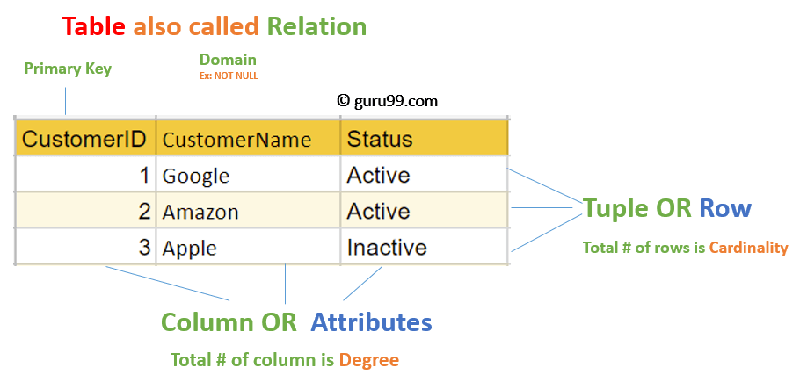

Slide 18
Relational Integrity constraints:
Relational Integrity constraints is referred to conditions which must be present for a valid relation. These integrity constraints are derived from the rules in the mini-world that the database represents.
There are many types of integrity constraints. Constraints on the Relational database management system is mostly divided into three main categories are:
  Domain constraints
  Key constraints
  Referential integrity constraints

Slide 19
Domain Constraints
Domain constraints can be violated if an attribute value is not appearing in the corresponding domain or it is not of the appropriate data type.
Domain constraints specify that within each tuple, and the value of each attribute must be unique.
This is specified as data types which include standard data types integers, real numbers, characters, Booleans, variable length strings, etc.
Example:
Create DOMAIN CustomerNameCHECK (value not NULL)
The example shown demonstrates creating a domain constraint such that CustomerName is not NULL
Key constraints
An attribute that can uniquely identify a tuple in a relation is called the key of the table. The value of the attribute for different tuples in the relation has to be unique.
Example:
In the given table, CustomerID is a key attribute of Customer Table. It is most likely to have a single key for one customer, CustomerID =1 is only for the CustomerName =" Google".

Slide 20
CustomerID | CustomerName | Status
1 | Google | Active
2 | Amazon | Active
3 | Apple | Inactive

Slide 21
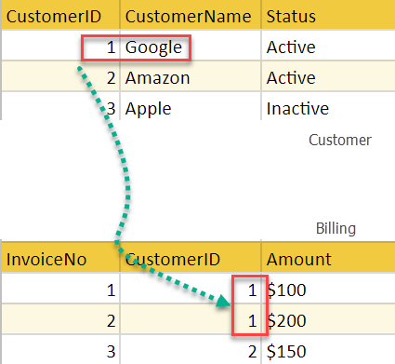
Referential integrity constraints:
Referential integrity constraints is base on the concept of Foreign Keys. A foreign key is an important attribute of a relation which should be referred to in other relationships. Referential integrity constraint state happens where relation refers to a key attribute of a different or same relation. However, that key element must exist in the table.
Example:
In the above example, we have 2 relations, Customer and Billing.
Tuple for CustomerID =1 is referenced twice in the relation Billing.
So we know CustomerName=Google has billing amount $300

Slide 22
Operations in Relational Model
Four basic update operations performed on relational database model are
Insert, update, delete and select.
  Insert is used to insert data into the relation
  Delete is used to delete tuples from the table.
  Modify allows you to change the values of some attributes in existing tuples.
  Select allows you to choose a specific range of data.
Whenever one of these operations are applied, integrity constraints specified on the relational database schema must never be violated.

Slide 23
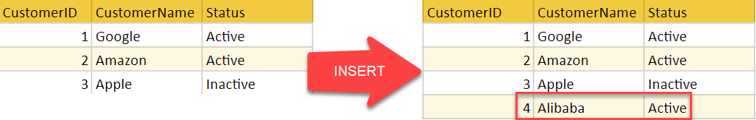
Insert Operation
The insert operation gives values of the attribute for a new tuple which should be inserted into a relation.

Slide 24
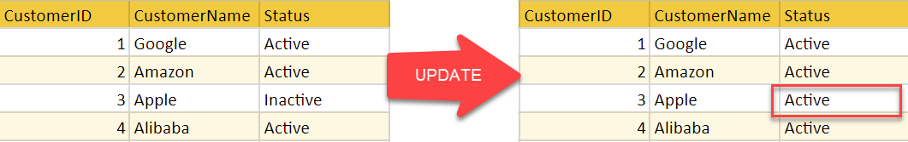
Update Operation
You can see that in the below-given relation table CustomerName= 'Apple' is updated from Inactive to Active.

Slide 25
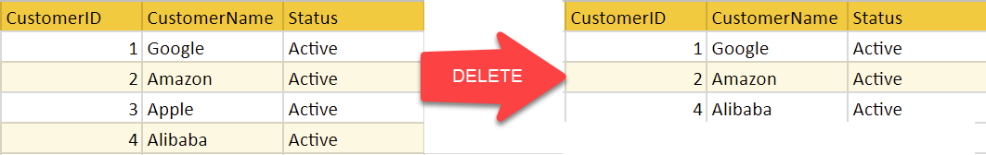
Delete Operation
To specify deletion, a condition on the attributes of the relation selects the tuple to be deleted.
In the above-given example, CustomerName= "Apple" is deleted from the table.
The Delete operation could violate referential integrity if the tuple which is deleted is referenced by foreign keys from other tuples in the same database.

Slide 26
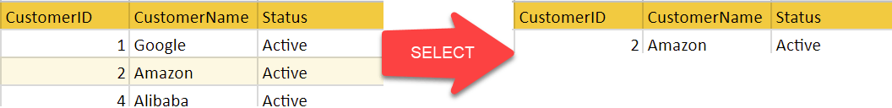
Select Operation
In the above-given example, CustomerName="Amazon" is selected

Slide 27
Best Practices for creating a Relational Model
Data need to be represented as a collection of relations
Each relation should be depicted clearly in the table
Rows should contain data about instances of an entity
Columns must contain data about attributes of the entity
Cells of the table should hold a single value
Each column should be given a unique name
No two rows can be identical
The values of an attribute should be from the same domain

Slide 28
Advantages of using Relational model
Simplicity: A relational data model is simpler than the hierarchical and network model.
Structural Independence: The relational database is only concerned with data and not with a structure. This can improve the performance of the model.
Easy to use: The relational model is easy as tables consisting of rows and columns is quite natural and simple to understand
Query capability: It makes possible for a high-level query language like SQL to avoid complex database navigation.
Data independence: The structure of a database can be changed without having to change any application.
Scalable: Regarding a number of records, or rows, and the number of fields, a database should be enlarged to enhance its usability.

Slide 29
Disadvantages of using Relational model
Few relational databases have limits on field lengths which can't be exceeded.
Relational databases can sometimes become complex as the amount of data grows, and the relations between pieces of data become more complicated.
Complex relational database systems may lead to isolated databases where the information cannot be shared from one system to another.

Slide 30
In Nutshell
The Relational database model represents the database as a collection of relations (tables)
Attribute, Tables, Tuple, Relation Schema, Degree, Cardinality, Column, Relation instance, are some important components of Relational Model
Relational Integrity constraints are referred to conditions which must be present for a valid relation
Domain constraints can be violated if an attribute value is not appearing in the corresponding domain or it is not of the appropriate data type
Insert, Select, Modify and Delete are operations performed in Relational Model
The relational database is only concerned with data and not with a structure which can improve the performance of the model
Advantages of relational model is simplicity, structural independence, ease of use, query capability, data independence, scalability.
Few relational databases have limits on field lengths which can't be exceeded.

Slide 31
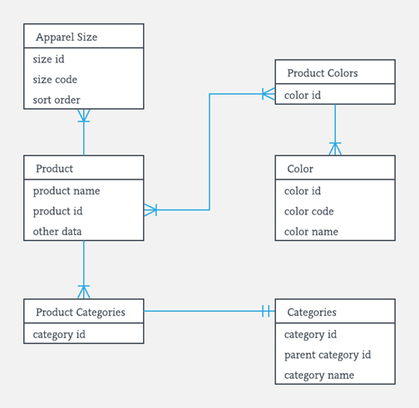
What is ER Diagrams?
ENTITY-RELATIONSHIP DIAGRAM (ERD) displays the relationships of entity set stored in a database.
It helps you to explain the logical structure of databases. At first look, an ER diagram looks very similar to the flowchart.
However, ER Diagram includes many specialized symbols, and its meanings make this model unique.
The purpose of ER Diagram is to represent the entity framework infrastructure.

Slide 32
Facts about ER Diagram Model:
ER model allows you to draw Database Design
It is an easy to use graphical tool for modelling data
Widely used in Database Design
It is a GUI representation of the logical structure of a Database
It helps you to identifies the entities which exist in a system and the relationships between those entities

Slide 33
Why use ER Diagrams?
The prime reasons for using the ER Diagram
  Helps you to define terms related to entity relationship modelling
  Provides a preview of how all your tables should connect, what fields are going to be on each table
  Helps to describe entities, attributes, relationships
  ER diagrams are translatable into relational tables which allows you to build databases quickly
  ER diagrams can be used by database designers as a blueprint for implementing data in specific software applications
  The database designer gains a better understanding of the information to be contained in the database with the help of ERP diagram
  ERD is allowed you to communicate with the logical structure of the database to users

Slide 34
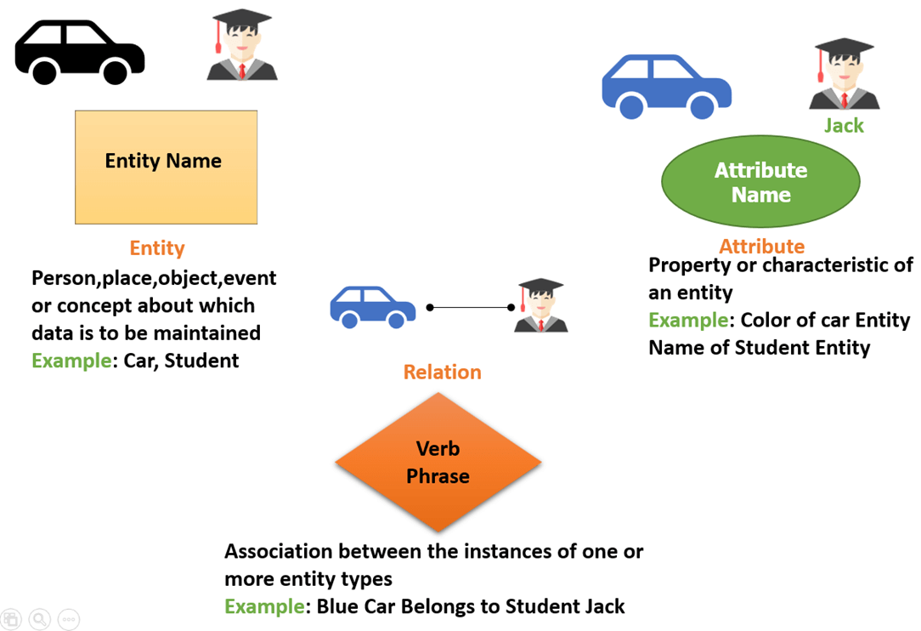
Components of the ER Diagram
This model is based on three basic concepts:
Entities
Attributes
Relationships
Example
For example, in a University database, we might have entities for Students, Courses, and Lecturers. Students entity can have attributes like Rollno, Name, and DeptID. They might have relationships with Courses and Lecturers.

Slide 35
WHAT IS ENTITY?
A real-world thing either living or non-living that is easily recognizable and non-recognizable. It is anything in the enterprise that is to be represented in our database. It may be a physical thing or simply a fact about the enterprise or an event that happens in the real world.
An entity can be place, person, object, event or a concept, which stores data in the database. The characteristics of entities are must have an attribute, and a unique key. Every entity is made up of some 'attributes' which represent that entity.
Examples of entities:
Person: Employee, Student, Patient
Place: Store, Building
Object: Machine, product, and Car
Event: Sale, Registration, Renewal
Concept: Account, Course

Slide 36
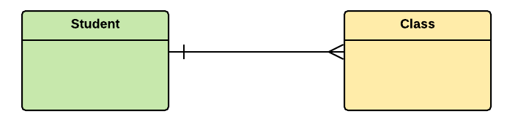
Notation of an Entity
Entity set:
Student
An entity set is a group of similar kind of entities. It may contain entities with attribute sharing similar values. Entities are represented by their properties, which also called attributes. All attributes have their separate values. For example, a student entity may have a name, age, class, as attributes.
Example of Entities:
A university may have some departments. All these departments employ various lecturers and offer several programs.
Some courses make up each program. Students register in a particular program and enroll in various courses. A lecturer from the specific department takes each course, and each lecturer teaches a various group of students.

Slide 37
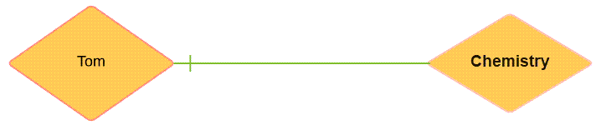
Relationship
Relationship is nothing but an association among two or more entities. E.g., Tom works in the Chemistry department.
Entities take part in relationships. We can often identify relationships with verbs or verb phrases.
For example:
You are attending this lecture
I am giving the lecture
Just loke entities, we can classify relationships according to relationship-types:
A student attends a lecture
A lecturer is giving a lecture.

Slide 38
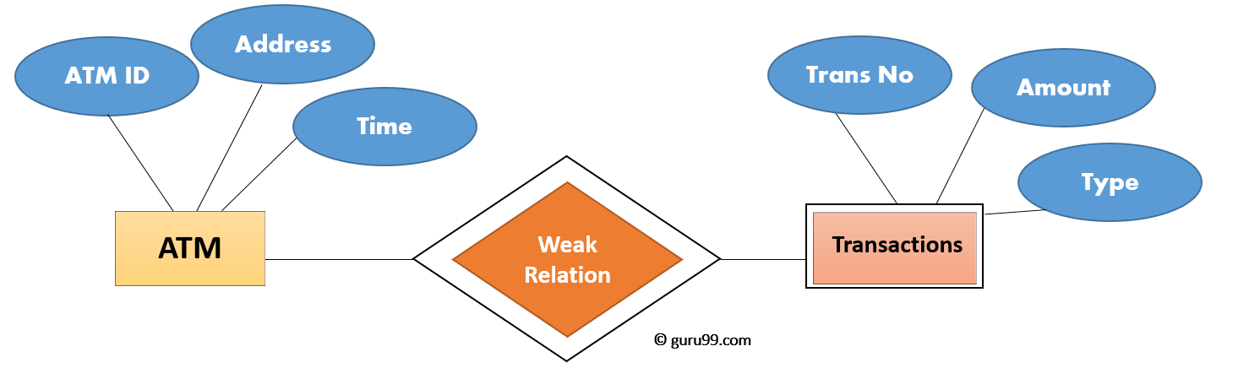
Weak Entities:
A weak entity is a type of entity which doesn't have its key attribute. It can be identified uniquely by considering the primary key of another entity.
For that, weak entity sets need to have participation.
In above example, "Trans No" is a discriminator within a group of transactions in an ATM.

Slide 39
Strong Entity Set | Weak Entity Set
Strong entity set always has a primary key. | It does not have enough attributes to build a primary key.
It is represented by a rectangle symbol. | It is represented by a double rectangle symbol.
It contains a Primary key represented by the underline symbol. | It contains a Partial Key which is represented by a dashed underline symbol.
The member of a strong entity set is called as dominant entity set. | The member of a weak entity set called as a subordinate entity set.
Primary Key is one of its attributes which helps to identify its member. | In a weak entity set, it is a combination of primary key and partial key of the strong entity set.
In the ER diagram the relationship between two strong entity set shown by using a diamond symbol. | The relationship between one strong and a weak entity set shown by using the double diamond symbol.
The connecting line of the strong entity set with the relationship is single. | The line connecting the weak entity set for identifying relationship is double.

Slide 40
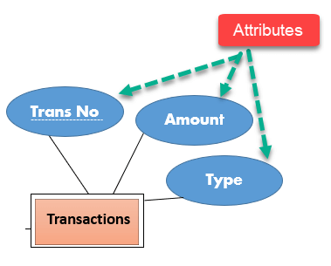
Attributes
It is a single-valued property of either an entity-type or a relationship-type.
For example, a lecture might have attributes: time, date, duration, place, etc.
An attribute is represented by an Ellipse

Slide 41
Cardinality
Defines the numerical attributes of the relationship between two entities or entity sets.
Different types of cardinal relationships are:
One-to-One Relationships
One-to-Many Relationships
Many to One Relationships
Many to Many Relationships
Types of Attributes | Description
Simple attribute | Simple attributes can't be divided any further. For example, a student's contact number. It is also called an atomic value.
Composite attribute | It is possible to break down composite attribute. For example, a student's full name may be further divided into first name, second name, and last name.
Derived attribute | This type of attribute does not include in the physical database. However, their values are derived from other attributes present in the database. For example, age should not be stored directly. Instead, it should be derived from the DOB of that employee.
Multivalued attribute | Multivalued attributes can have more than one values. For example, a student can have more than one mobile number, email address, etc.

Slide 42
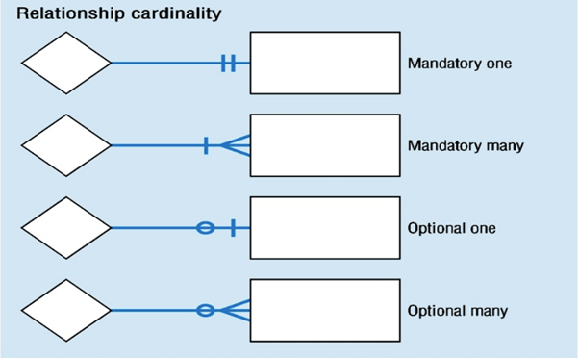

Slide 43
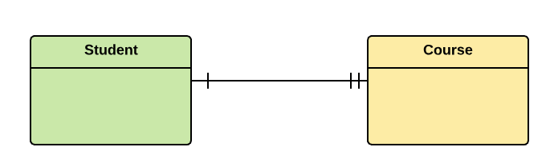
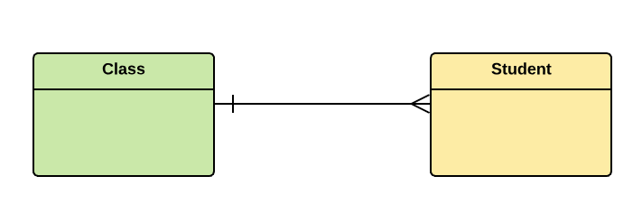
1.One-to-one:
One entity from entity set X can be associated with at most one entity of entity set Y and vice versa.
Example: One student can register for numerous courses. However, all those courses have a single line back to that one student.
2.One-to-many:
One entity from entity set X can be associated with multiple entities of entity set Y, but an entity from entity set Y can be associated with at least one entity.
For example, one class is consisting of multiple students.

Slide 44
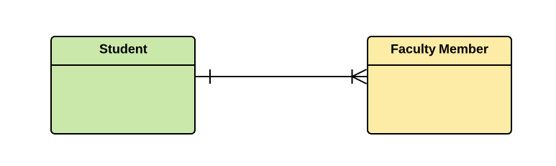
3. Many to One
More than one entity from entity set X can be associated with at most one entity of entity set Y. However, an entity from entity set Y may or may not be associated with more than one entity from entity set X.
For example, many students belong to the same class.
4. Many to Many:
One entity from X can be associated with more than one entity from Y and vice versa.
For example, Students as a group are associated with multiple faculty members, and faculty members can be associated with multiple students.

Slide 45
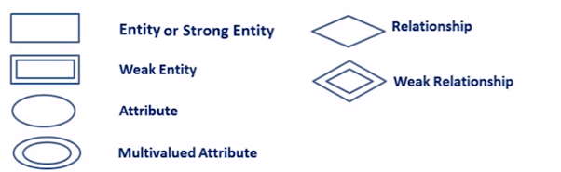
ER- Diagram Notations
ER- Diagram is a visual representation of data that describe how data is related to each other.
Rectangles: This symbol represent entity types
Ellipses : Symbol represent attributes
Diamonds: This symbol represents relationship types
Lines: It links attributes to entity types and entity types with other relationship types
Primary key: attributes are underlined
Double Ellipses: Represent multi-valued attributes

Slide 46

Steps to Create an ERD
Following are the steps to create an ERD.
Let's study them with an example:
In a university, a Student enrolls in Courses. A student must be assigned to at least one or more Courses. Each course is taught by a single Professor. To maintain instruction quality, a Professor can deliver only one course

Slide 47
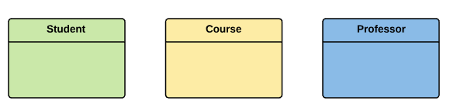
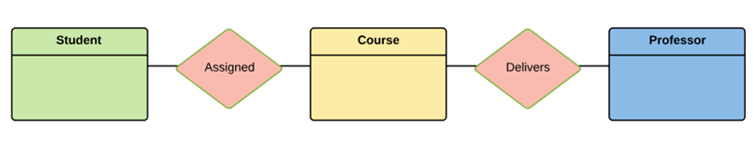
Step 1) Entity Identification
We have three entities
Student
Course
Professor
Step 2) Relationship Identification
We have the following two relationships
The student is assigned a course
Professor delivers a course

Slide 48
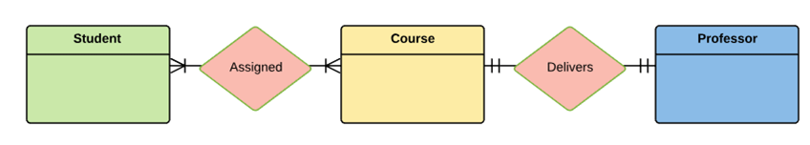
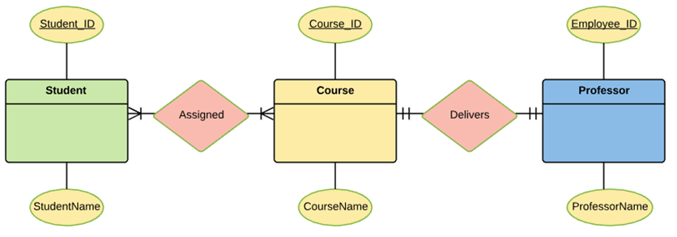
Step 3) Cardinality Identification
For them problem statement we know that,
A student can be assigned multiple courses
A Professor can deliver only one course
Entity | Primary Key | Attribute
Student | Student_ID | StudentName
Professor | Employee_ID | ProfessorName
Course | Course_ID | CourseName
Step 4) Identify Attributes
Once, you have a list of Attributes, you need to map them to the identified entities. Ensure an attribute is to be paired with exactly one entity. If you think an attribute should belong to more than one entity, use a modifier to make it unique.
Once the mapping is done, identify the primary Keys. If a unique key is not readily available, create one.

Slide 49
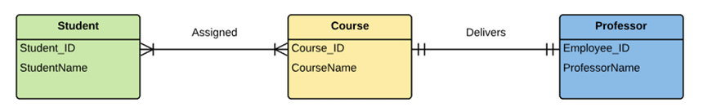
For Course Entity, attributes could be Duration, Credits, Assignments, etc. For the sake of ease we have considered just one attribute.
Step 5) Create the ERD
A more modern representation of ERD Diagram

Slide 50
Best Practices for Developing Effective ER Diagrams
Eliminate any redundant entities or relationships
You need to make sure that all your entities and relationships are properly labelled
There may be various valid approaches to an ER diagram. You need to make sure that the ER diagram supports all the data you need to store
You should assure that each entity only appears a single time in the ER diagram
Name every relationship, entity, and attribute are represented on your diagram
Never connect relationships to each other
You should use colors to highlight important portions of the ER diagram

Slide 51
Summary
The ER model is a high-level data model diagram
ER diagrams are a visual tool which is helpful to represent the ER model
Entity relationship diagram displays the relationships of entity set stored in a database
ER diagrams help you to define terms related to entity relationship modelling.
ER model is based on three basic concepts: Entities, Attributes and Relationships
An entity can be place, person, object, event or a concept, which stores data in the database
Relationship is nothing but an association among two or more entities
A weak entity is a type of entity which doesn't have its key attribute.
It is a single-valued property of either an entity-type or a relationship-type
It helps you to define the numerical attributes of the relationship between two entities or entity sets
ER- Diagram is a visual representation of data that describe how data is related to each other.
While Drawing ER diagram you need to make sure all your entities and relationships are properly labelled.

Slide 52
The relational data model describes the world as “a collection of inter-related relations (or tables).”
Fundamental Concepts in the Relational Data Model
Relation
A relation, also known as a table or file, is a subset of the Cartesian product of a list of domains characterized by a name. And within a table, each row represents a group of related data values. A row, or record, is also known as a tuple. The columns in a table is a field and is also referred to as an attribute. You can also think of it this way: an attribute is used to define the record and a record contains a set of attributes.
The steps below outline the logic between a relation and its domains.
Given n domains are denoted by D1, D2, … Dn
And r is a relation defined on these domains
Then r ⊆ D1×D2×…×Dn
Table
A database is composed of multiple tables and each table holds the data.

Slide 53
Column
A database stores pieces of information or facts in an organized way. Understanding how to use and get the most out of databases requires us to understand that method of organization.
The principal storage units are called columns or fields or attributes. These house the basic components of data into which your content can be broken down. When deciding which fields to create, you need to think generically about your information, for example, drawing out the common components of the information that you will store in the database and avoiding the specifics that distinguish one item from another.
Look at the example of an ID card in Figure 7.2 to see the relationship between fields and their data.

Slide 54
Domain
A domain is the original sets of atomic values used to model data. By atomic value, we mean that each value in the domain is indivisible as far as the relational model is concerned. For example:
The domain of Marital Status has a set of possibilities: Married, Single, Divorced.
The domain of Shift has the set of all possible days: {Mon, Tue, Wed…}.
The domain of Salary is the set of all floating-point numbers greater than 0 and less than 200,000.
The domain of First Name is the set of character strings that represents names of people.
In summary, a domain is a set of acceptable values that a column is allowed to contain. This is based on various properties and the data type for the column. We will discuss data types in another chapter.

Slide 55
Records:
A Record ID field: this is an ordinal number; its data type is an integer.
A PubDate field: this is displayed as day/month/year; its data type is date.
An Author field: this is displayed as Initial. Surname; its data type is text.
A Title field text: free text can be entered here.
You can command the database to sift through its data and organize it in a particular way. For example, you can request that a selection of records be limited by date: 1. all before a given date, 2. all after a given date or 3. all between two given dates. Similarly, you can choose to have records sorted by date. Because the field, or record, containing the data is set up as a Date field, the database reads the information in the Date field not just as numbers separated by slashes, but rather, as dates that must be ordered according to a calendar system.
Properties of a Table
A table has a name that is distinct from all other tables in the database.
There are no duplicate rows; each row is distinct.
Entries in columns are atomic. The table does not contain repeating groups or multivalued attributes.
Entries from columns are from the same domain based on their data type including:
  number (numeric, integer, float, smallint,…)
  character (string)
  date
  logical (true or false)

Slide 56
FLAT FILE DATABASE:
A flat-file database is a database stored in a file called a flat file.
Records follow a uniform format, and there are no structures for indexing or recognizing relationships between records.
The file is simple. A flat file can be a plain text file, or a binary file.
A flat file contains records that have no structured interrelationship.
A flat file typically consists of a text file, from which all word processing or other structure characters or mark-up have been removed.
Definition: Flat File Database:
A flat file database is a type of database that stores data in a single table. This is unlike a relational database, which makes use of multiple tables and relations.
Flat file databases are generally in plain-text form, where each line holds only one record. The fields in the record are separated using delimiters such as tabs and commas.

Slide 57
Features of the data in flat file databases include:
Database Management System: The text data represent an intermediate style of data before being loaded into the database.
Separated Columns: Flat file databases are based on fixed-width data formatting. Columns are separated using delimiter characters.
Data Types: Columns in the database tables are restricted to a particular data type and are not indicated, unless the data is passed on to a relational database.
Relational Algebra: Records in flat file database tables meet tuple definitions under relational algebra.

Slide 58
Flat file database Vs. relational database
A flat file is often mistaken for a relational database, but they are actually much different.
A flat file consists of a single table of data.
It allows the user to specify data attributes, such as columns and data types table by table, and stores those attributes separate from applications.
This type of file is commonly used to import data in data warehousing projects.
In relational databases, flat file is sometimes used as a synonym for a "relation."
A relational database contains multiple tables of data that relate to each other and allows the user to specify information about multiple tables and the relationships between those tables, allowing more flexibility and control over database constraints.

Slide 59
Advantages and Disadvantages of Flat Database File System
Advantages
Easy to understand.
Easy to implement.
Less hardware and software requirements.
Less Skills set are required to hand flat database systems.
Best for small databases.
Disadvantages
Less security easy to extract information.
Data Inconsistency
Redundancy
Sharing of information is cumbersome task
Slow for huge database
Searching process is time consuming
Understanding flat files in depth is the first step to mastering data loading. Flat files are the universal mechanism for moving data from one database or system to another.

Slide 60
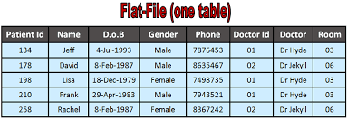

Slide 61
The difference between CSV and delimited files?
CSV files include both a delimiter and an optional enclosing character.
A delimiter separates the data fields. It is usually a comma, but can also be a pipe, a tab, or any single value character.
An enclosing character occurs at the beginning and the end of a value. It is sometimes called a quote character (because it is usually double quotes), but you can use another character instead.
Delimited files only have a delimiter; an enclosing character is not used.
CSV is the only format that will guarantee seamless data movement between systems.
But there are other instances where delimited files make sense, like when you're more comfortable working with this type of file and the delimiter itself does not occur within the data.
Simply put, there's a time and place to use each.

Slide 62
The End

